Slide 1
AWS
Part 1

Slide 2
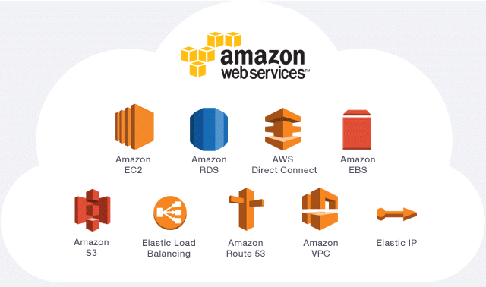

Slide 3
Table of content
Introduction to AWS
Creating your account on AWS
Launching your first EC2 instance in AWS
Accessing the instance through MobaXterm

Slide 4
Introduction
1
What is AWS?

Slide 5
Introduction
The cloud is a computer service that can be accessed through the internet
For example, Instead of having a physical server for database in your company, you can use just a URl to launch a server in someone else’s Datacenter or Database!
The cloud is very fast growing and now, we have many types of services provided such as: databases, servers, apps etc.

Slide 6
Introduction
The cloud is a tool that helps many company to reduce costs: It is a Pay-As-You-Go service.
This means, you are charged only for what you use
One of the biggest providers of cloud services is AWS (Amazon Web services)
There are other cloud services providers such as Microsoft Azure, Google cloud, etc.

Slide 7
Introduction
AWS provides services like:
Storage
Development tools
Compute services
Security services
Monitoring
...
As an IT professional, you ought to know some notions about cloud services

Slide 8
How to create an account on AWS
2
Starting with AWS

Slide 9
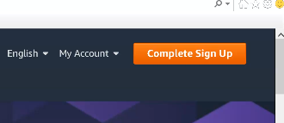
Create an account on AWS
To create your account, you need to
Launch the browser
Open the AWS page with: aws.amazon.com
Then click on complete Sign up

Slide 10
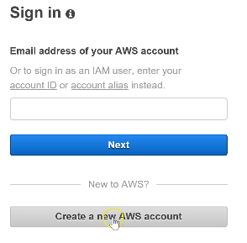
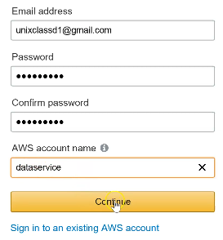
Create an account on AWS
Fill the form and click on Continue
Click on Create a new account

Slide 11
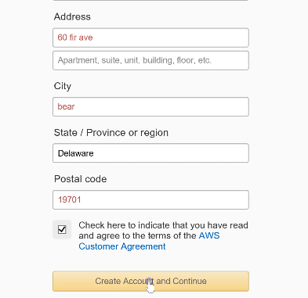
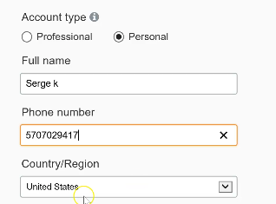
Create an account on AWS
Fill the Contact Information form
Then click on Create account

Slide 12
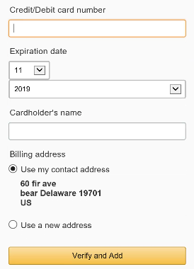
Create an account on AWS
Fill the for Payment information
Put a valid credit card number and expiration date
Put the cardholder’s name
Check Use my contact address as Billing address
Click on Verify and add

Slide 13
Here, they will pull one dollar from your account to make sure it is valid. But they you give it back later!

Slide 14
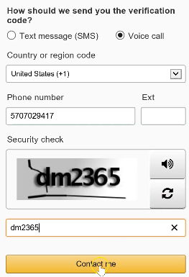
Create an account on AWS
Fill the form to Confirm your Identity
Choose voice call
Put your phone number
Enter the code for security check
Then click on Contact me

Slide 15
If the phone number is valid, you will receive a call. A code will display on your screen and you need to enter that code in your phone for verification
Click on Continue

Slide 16
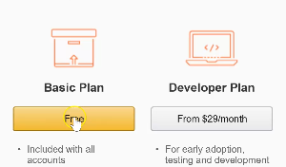

Create an account on AWS
Select a Support plan
Choose Basic Plan by clicking on Free
Then click on Sign in to the console

Slide 17


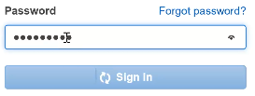
Create an account on AWS
Click on Sign in with root credentials
Put the Email address you used to create your account
Click on Next
Enter the password
Click on Sign in

Slide 18
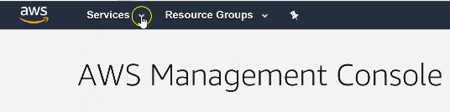
Create an account on AWS
You are now logged in to the AWS console
You can check all the services provided by clicking on Services
We will use just few of them

Slide 19
The Billing Dashboard
How much are you consuming?

Slide 20
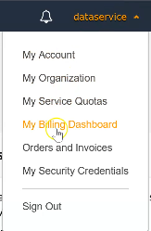
Create an account on AWS
To check the Billing dashboard, click on you account name
Then click on My billing dashboard
This will show you at any time how much you are consuming with your AWS account
Click on the aws button at the left

Slide 21
The hosting Region
What for?

Slide 22
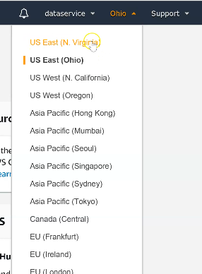
Create an account on AWS
Beside your account name, you also have the region where your services will be launched
Click on it to select a desired region according to your geographical location (Here I choose N Virginia)
NB: You can click on Support when you face a difficulty or an issue with an AWS service

Slide 23
Launching you first EC2 instance in AWS
3
Starting with AWS

Slide 24
Launching EC2 instance
EC2 stand for Elastic Cloud Compute.
It is an AWS service that provides servers for rent in the cloud.
The servers are called instances
Launching a server = Launching an EC2 instance
This service enables you to launch many servers based on your needs

Slide 25
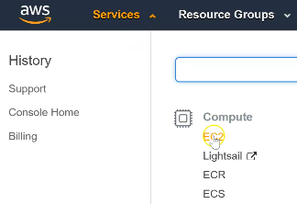
Launching EC2 instance
To launch an instance
Click on Services
Then choose EC2 in the Compute services
Click on Launch instance

Slide 26
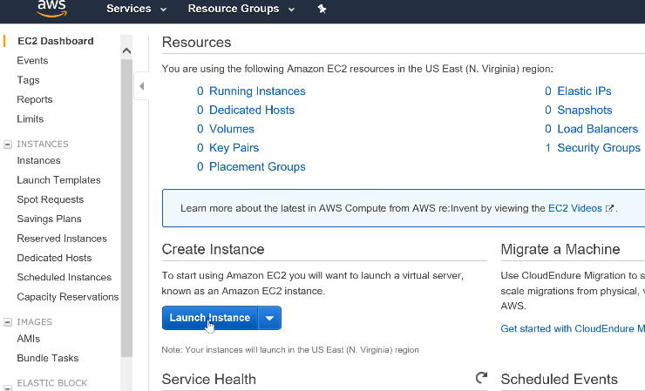

Slide 27
Launching EC2 instance
Step 1: Choose an Amazon Machine Image (AMI)
Here you have a list of Amazon images (these represent the OS that will be installed in your instance )
Choose the Amazon Linux 2 AMI (HVM), SDD volume type (64-bit x86)
Click on Select

Slide 28
Launching EC2 instance
Step 2: Choose and Instance type
This is where you choose some caracteristiques like the memory size, the number of CPUs etc.
For now, let’s stay with the Free tier eligible type t2 micro (1 CPU and 1G memory)
This, can be used for one year without being charged
Click on Next: configure Instance Details

Slide 29

Launching EC2 instance
Step 3: Configure Instance Details
Allow the parameters values as default
Click on Next: Add storage
Step 4: Add storage
Allow the parameters values as default
Click on Next: Add Tag

Slide 30
Launching EC2 instance
Step 5: Add tag
Click on Add tag to add a new tag:
Click on Next: Configure Security Group
Key | value
Name | firstinstance

Slide 31
Launching EC2 instance
Step 6: Configure Security Group
The port 22 is opened here by default
Let’s open the ports 80 for Http and 443 for Https
To do that, click on Add Rule
Choose type HTTP: the protocol, the port range and other parameters will be filled automatically
Do the same for HTTPs
Click on Review and launch, then on Launch

Slide 32
Launching EC2 instance
Now you need to select an existing key pair or create a new one
Let’s create one:
Click on Choose existing key pair
Then click on Create a key pair
Give it a name : awskeypair
Click on Download key
Now click to Launch the instance

Slide 33
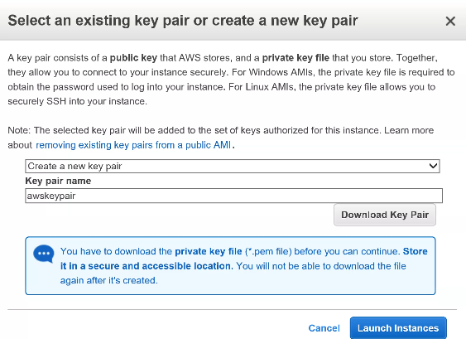

Slide 34


Launching EC2 instance
When you click on instances (in the left column),you will see your firstinstance pending
Then the instance will go to the Running state
In the EC2 dashboard, you will see 1 instance running

Slide 35
Accessing the EC2 instance through MobaXterm, VSC, Putty & puttygen
4
Starting with AWS

Slide 36
Accessing the EC2 instance
When our instance is running, we can use MobaXterm to access it remotely
Looking in our EC2 instance description, we can see its Public IP address, its Private DNS and even a Private IP address
Open your MobaXterm a click on Session
Then click on SSH
Here we need to provide the Instance’s IP address

Slide 37
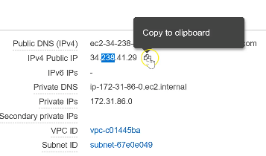
Accessing the EC2 instance
In the EC2 instance Description, copy the public IP address and paste it in MobaXterm
Check the Specify username and enter ec2-user
Click on Advanced ssh settings

Slide 38
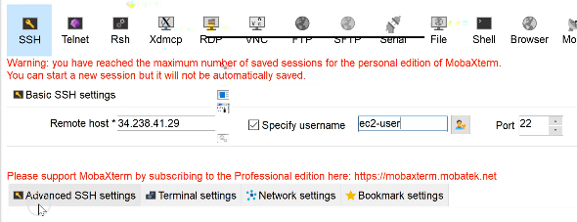
Accessing the EC2 instance
Check the Specify username and enter ec2-user
Click on Advanced ssh settings

Slide 39
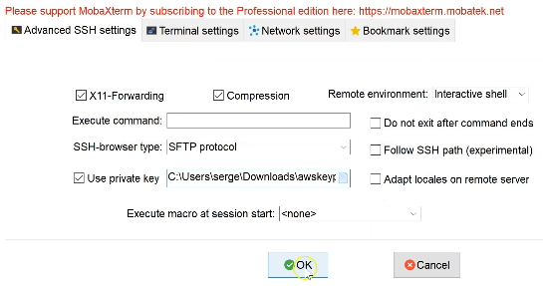
Accessing the EC2 instance
Check the Use private key button
Browse to the Download folder and open the awskeypair file we created during our instance creation in aws.
Click on OK

Slide 40
Accessing the EC2 instance
We are now connected to the EC2 instance
You can type some command
# sudo -i
# lsblk to check the hard drive
NB: You can use the same process to create another EC2 instance to make sure you can follow the various steps

Slide 41
Accessing the EC2 instance
Let’s install Apache on our Instance: Remember the port is already open (during the instance creation)
# yum install httpd -y
# systemctl start httpd
Now copy the Public IP address of your instance and paste it the browser (without the port number)
You get the Apache test page

Slide 42
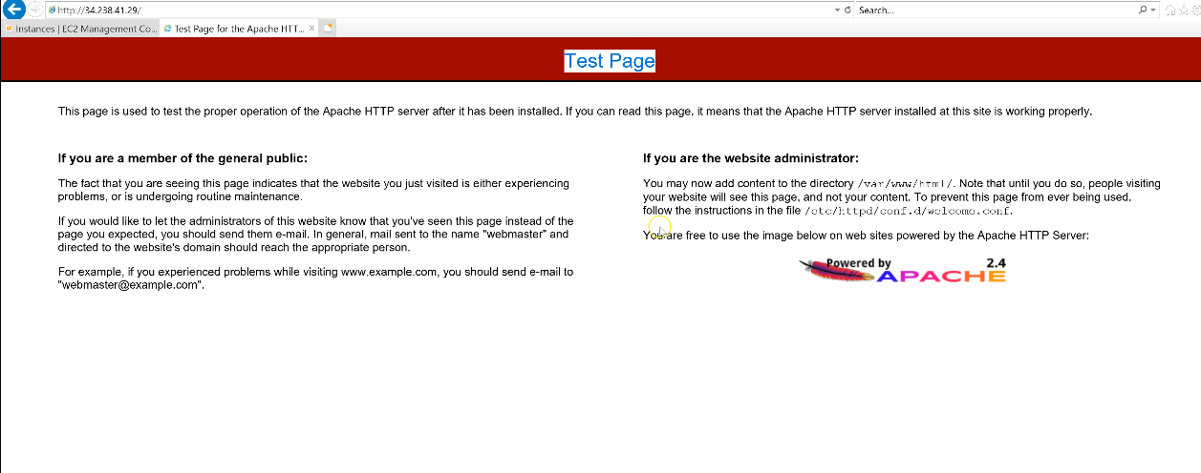

Slide 43
Terminate the instance
This is a must!

Slide 44
Accessing the EC2 instance
When you are done with an instance in AWS, always Stop or Terminate it to avoid charges
To do that,
Open the EC2 service
Click on Instances
Check the instance button

Slide 45
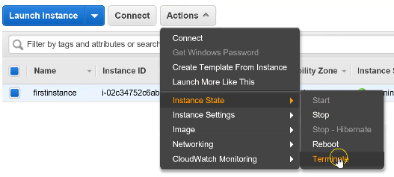
Accessing the EC2 instance
Now click on Actions
Choose Instance state
Then click on Stop or better on Terminate

Slide 46
Practice this and always feel free to post your questions to me

Slide 47
Thanks!
Any questions?
You can find us at:
website: http://utrains.org/
Phone: +1 (302) 689 3440
Email: contact@unixtrainings.com

Slide 48
Click on the link below to contact the support team for any issue!
utrains.org/support/
Create a ticket for your problem and we will get back to you soon!

